Slide 1
CSE-1st Semester
Programing with C language.
C, computer programming language developed in the early 1970s by American computer scientist Dennis M. Ritchie.

Slide 2
Source code: Source code is a collection of instructions written in a programming language that a computer can understand and execute. It serves as the human-readable version of a program, allowing developers to write, modify, and maintain software.
Object code: Object code is the machine-readable output generated from source code after it has been compiled. It consists of binary instructions that a computer's processor can execute directly. Object code is typically not human-readable, as it is in a format specific to the target machine's architecture.
Translator program: A translator program is software that converts code written in one programming language into another. There are several types of translator programs: Compiler, Interpreter, Assembler etc.
Compiler: Translates source code (high-level language) into machine code (object code) in one go, producing an executable file. Examples include GCC for C/C++ and javac for Java.
Interpreter: Translates and executes source code line-by-line or statement-by-statement at runtime, without producing a separate executable file. Examples include Python's CPython.
Assembler: Converts assembly language code into machine code. Assemblers translate low-level code that is closely related to the architecture of the computer.
Programing symbols:
Normal symbol | C operators
+ | +
- | -
x | *
÷ | /

Slide 3


Variables: It is a name of a memory location which stores some data.
1
0
3
5
Memory
Data
a
B
c
b
Variable
Variables are case sensitive.(b and B are not same)
1st character should be alphabet or ‘_’ (Underscore).
No comma , blanks, dot or any other special character can not be used (* ‘_’).
Variables can change by statements.
Keyword(int, double, else, long, short, continue, default, const, do, sizeof, goto, switch, for etc.) can’t be used as a variable.
Variable type:
Integer | Fraction |  | Character
int | float | double | char
%d | %f | %lf | %c | %s
Format specifier
Single cote(‘ ’)
For 1 letter
For multiple letter
Double cote(“ ”)

Slide 4

Data type | Byte
char | 1
int | 2
long int | 4
float | 4
double | 8
long double | 10
Program structure:
#include<stdio.h>
int main(){
return 0;
}
Header file / Preprocessor directive.
Main function; all process starts after this.
Line break: ‘ \n ’.
Input: ‘ scanf(“% d”,&s); ’
Output: ‘ printf(“__ %d”, s); ’
Comments: Lines that are not part of program.
Single line comments.(//comment)
Multiple line comments.(/*comments*/)
Operators Precedence:(Priority wise)
!
*,/,%
+,-
<,<=,>,>=
==,!=
&&
||
=
Operators:
Doing short.
(Assign. ope. Is also known as Short hand ope.)
Decreases
Associativity:(For same line)
Left to Right.
4*3/6*3 = 12/6*2 = 2*2 = 4 .
(4*3)/(6*3) = 12/18 = 0 .(0.67)
5+2/2*3 = 5+1*3 = 5+3 = 8 .
5*2-3*2 = 10-6 = 4 .
Arithmetic operator: +, -, *, /, %
Relational operator: ==, >, >= , <, <= , !=
Logical operator: &&, ||, !
Assignment operator: =, +=, -=, *=, /=, %= (a =a%b a%=b)
Bitwise operator: Operator that is used for bit number(0,1).
Ternary operator: Also called as conditional operator, is used
instead of “if….else”.

Slide 5

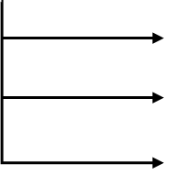
Type declaration instructions.
Arithmetic instructions.
Control instructions.
Type declaration: (Always declare variables before using it)
Right example:
1. int a = 25;
int b = 2* a;
2. int a,b,c;
a=b=c=1
Wrong example:
1. int a = 25;
int c = a*b;
int b = 22;
2. int a=b=c=1;
(=) it is an assignment operator. It assign a value to variables.
A variable should first declare than use.
For multi-assign ,first declare than multi-assign. Declaration and multi-assign can’t be used parallelly.

Slide 6
Arithmetic instructions:
x = a + b;
Valid :
a = b + c;
a = b * c;
a = b + c + d;
Invalid :
a = b c;
b + c = a;
a = b (c)^-1;
Result (Single variable)
Operand/ Variables(As much as u like)
Type conversion:
int OP int = int
int OP double = double
float OP float = float
Type Cast : (A part of type conversion)
(int) 1.25562 = 1
(double) 1= 1.00000000
->(type) variable or number = result will be converted in the type.
Control instructions: ->Determine flow of program.
Sequence control : Sequence wise write.
Decision control : if..else.
Loop control : for, while, do…while.
Case control : Case dec. wise (what to do and not to do).
Heder file
Type dec.
Variable dec.
Process

Slide 7
Practice some examples.. Using operators..
Conditional statements:
int a=10;
int b=7;
if(a>b){
printf("A is big");
}
else{
printf("B is big");
}
If….else :
If(condition){
process(if the condition is true)
}
else{
process(if the condition is false)
}
If…else if :
if(condition1){
process(if condition1 is true)
}
else if(condition2){
process(if condition1 is false and condition2 is true)
}
else{
process(if condition2 is false)
}
int a=10;
int b=70;
if(a>b){
printf("A is big");
}
else if(b>a){
printf("B is big");
}
else {
printf("A and B is equal");
}
In case 1st if is true than else if and else won’t be check.

Slide 8
Multiple if :
if(condition1){
process(if condition1 is true)
}
if(condition2){
process(if condition2 is true)
}
if(condition3){
process(if condition3 is true)
}
int a=10;
int b=20;
if(a>0){
printf("A is positive\n");
}
if(b>0){
printf("B is positive\n");
}
if((b%2==0)&&(a%2==0)){
printf("A and B is even\n");
}
This time all if will be check.
Nested if…else : (if…else inside if)
if(condition1){
(if condition1 is true)
process;
if(condition2){
process(if condition2 is true)
}
else{
process(if condition2 is false)
}
else{
(if condition1 is false)
process;
if(condition3){
process(if condition3 is true)
}
else{
process(if condition3 is false)
}
In case 1st if is false than if..else inside 1st if won’t be check but else and if..else inside else will be check. On the other hand in case the 1st if is true than ,if..else inside 1st if will be check and else and it’s part won’t be check.

Slide 9
Practice nested if..else and other conditional statement..
ASCAII value : (Decimal value of character and symbols. )
(‘A’=65 to ‘Z’=90), (‘a’=97 to ‘z’=122) others are for symbols.
Write a program to find a character entered by user , is upper case or lower case..
Answer:
  #include<stdio.h>
  int main(){
  char character;
  printf("Enter character: ");
  scanf("%c", &character);
  if (character >= 'A'&& character <= 'Z'){
  printf("Upper case\n");
  }
  else if (character >= 'a' && character <= 'z'){
  printf("Lower case\n");
  }
  else printf("Not a character\n");
  return 0;
  }

Slide 10
Ternary operator : (A short form of if..else; used instead of if..else.)
  Syntax :
  (condition)? process(if true) : process(if false) ;
Ex:
#include<stdio.h>
int main(){
int a=7;
(a%2==0)? printf("Even") : printf("Odd");
return 0;
}
Answer: Odd
Called ‘if not’
Switch : (Case in order)
Syntax:
switch(day){
case 1: Process(if input is 1);
break;
case 2: Process(if input is 2);
break;
case 3: Process(if input is 3);
break;
default : Process(if input not available );
}
Ex:
#include<stdio.h>
int main(){
int day;
printf("Enter day(1-7): ");
scanf("%d", &day);
switch(day){
case 1:printf("monday");
break;
case 2:printf("tuesday");
break;
case 3:printf("wednesday");
break;
case 4:printf("thursday");
break;
case 5:printf("friday");
break;
case 6:printf("saturday");
break;
case 7:printf("sunday");
break;
default :printf("not valid");
}
return 0;
}
Input Variable
Breaks the switch if current case is true.
Works if all case is false.

Slide 11
Nested Switch : (Switch in switch)
Syntax:
switch (x) {
case 1: Process(if x input is 1);
switch (y) {
          case 1: Process(if x input is 1 & y input is 1); break;
          case 2: Process(if x input is 1 & y input is 2);
          break;
          }
        break;
        case 2: Process(if x input is 2);
        switch (y) {
          case 1: Process(if x input is 2 & y input is 1); break;
          case 2: Process(if x input is 2 & y input is 2);
          break;
          }
        break;
        default: printf( "Choice is not available");
Ex:
#include <stdio.h>
int main()
{
int x = 1, y = 2;
switch (x) {
case 1: printf( "Choice x is 1");
switch (y) {
case 1:
printf( "Choice y is 1");
break;
case 2:
printf( "Choice y is 2");
break;
}
break;
case 2: printf( "Choice x is 2");
switch (y) {
case 1:
printf( "Choice y is 1");
break;
case 2:
printf( "Choice y is 2");
break;
}
break;
default: printf( "Choice is not available");
}
return 0;
}
Breaks the switch if the current case is true, or continues until the default or another case is true.

Slide 12
Loop : 3 type. (for, while, do….while)
For loop:
Syntax:
for(initial statement; condition; upgrading statement){
Process;
}
Infinite loop: (a program that repeats indefinitely)
Causes:
  Incorrect Conditions.(Condition always true, No termination logic)
  Missing Updates.(Forgetting to update variables)
Increment operators : 2 type.(Pre-increment , post increment)
(++i) (i++)
(i++): In post-increment, the current value of the variable is used first, and then the variable is incremented.
code: printf(“%d\n”, i++);
printf(“%d\n”, i);
Output: (if i=1) ➔ 1 (i=1,i+1=2 in next line)
2
(++i): In pre-increment, the value of the variable is incremented first, and then the incremented value is used in the expression.
code: printf(“%d\n”, i++);
printf(“%d\n”, i);
Output: (if i=1) ➔ 2 (i=1,i+1=2 in current line)
2
Decrement operators : 2 type.(Pre-decrement, post decrement)
(--i) (i--)
Works same as Increment operators.
Ex : (Printing number 1 to 10)
#include <stdio.h>
    int main() {
        int i;
        for (i = 1; i < 11; ++i) {
        printf("%d ", i);
        }
        return 0;
        }
Output: 1 2 3 4 5 6 7 8 9 10

Slide 13
While loop:
Syntax:
initial statement or declaration
while(condition){
Process.
Upgrading statement.
}
Do…..while loop :
Syntax:
    initial statement or declaration
    do{
    Process.
    Upgrading statement.
    } while(condition);
Ex : (Printing number 1 to 10)
#include <stdio.h>
    int main() {
        int i = 1;
        while ( i < 11) {
        printf("%d ", i);
        i++;
        }
        return 0;
        }
Output: 1 2 3 4 5 6 7 8 9 10
Ex : (Printing number 1 to 10)
#include <stdio.h>
    int main() {
        int i = 1;
        do {
        printf("%d ", i);
        i++;
        } while ( i < 11);
        return 0;
        }
Output: 1 2 3 4 5 6 7 8 9 10

Slide 14
Break statement: The break statement is used to exit the loop immediately when a certain condition is met. It can be
use in loop without conditional statement but it has no usefulness. So generally it is used in a conditional statement.
Ex:
for(int i=1;i<10;i++)
      { if (i== 5){
      break;
        }
        printf("%d\n",i);
        }
Output :
1
    2
    3
    4
Stops after the condition (i=5) is true.
Continue statement : The continue statement is used to skip the current iteration (when the condition is true) and proceed to the next iteration. The loop itself continues running.
Ex:
for(int i=1;i<10;i++)
      { if (i== 5){
      break;
        }
        printf("%d\n",i);
        }
Output :
1
    2
    3
    4
    6
    7
    8
    9
Skips only single loop of (i=5) when condition (i=5) is true. But continue other loops.

Slide 15
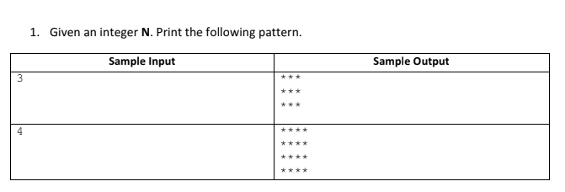
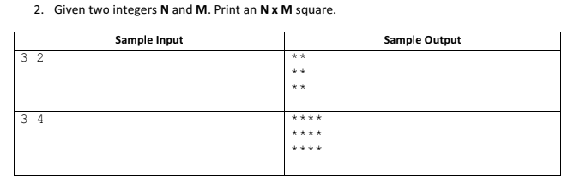
Pattern printing : It is a section that uses loop to print different types of pattern.
Answer:
#include<stdio.h>
int main(){
int n,i,j;
      scanf("%d", &n);
      for(i=1 ; i<=n ; i++){
      for(j=1 ; j<=n ; j++){
      printf("* ");
      }
      printf("\n");
      }
      return 0;
      }
Output: 5
  * * * * *
  * * * * *
  * * * * *
  * * * * *
  * * * * *
Answer:
#include<stdio.h>
    int main(){
    int n,m,i,j;
    scanf("%d%d", &n,&m);
    for(i=1 ; i<=n ; i++){
    for(j=1 ; j<=m ; j++){
    printf("* ");
    }
    printf("\n");
    }
    return 0;
    }
Output: 4 3
  * * *
  * * *
  * * *
  * * *

Slide 16
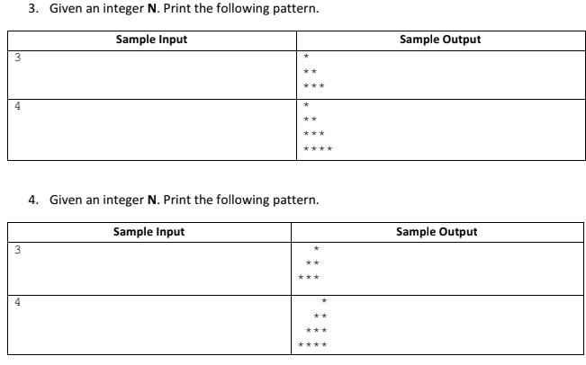
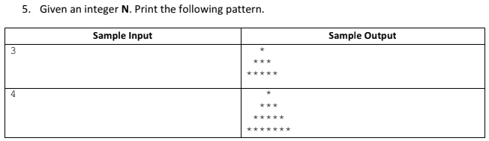
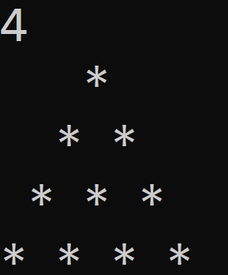
 | 1 | 2 | 3 | 4
1 | *
2 | * | *
3 | * | * | *
4 | * | * | * | *
for(i=1 ; i<=n ; i++){
for(j=1 ; j<=i ; j++){
printf("* ");
}
printf("\n");
}
In 3. no. ➔ for N=4➔
j
i
In 4. no. ➔ for N=4
j
 | 1 | 2 | 3 | 4
1 |  |  |  | *
2 |  |  | * | *
3 |  | * | * | *
4 | * | * | * | *
i
for(i=1 ; i<=n ; i++){
for(j=n ; j>=1 ; j--){
if(i>=j)
printf("* ");//*and a space
else printf(" ");//two space
}
printf("\n");
}
In 3. no. ➔ for N=4 ➔
for(i=1 ; i<=n ; i++){
for(j=n ; j>=1 ; j--){
if(i>=j)
printf("* ");//*and a space
else printf(" ");//two space
}
printf("\n");
}

Slide 17
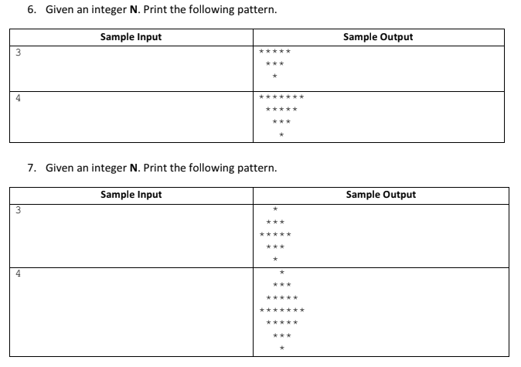
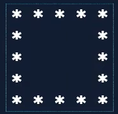
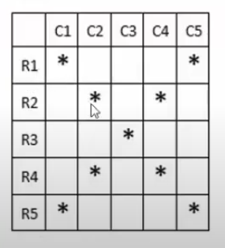
Practice this patterns.
8. Given an integer N. Print following pattern.
9. Given an integer N. Print following pattern.

Slide 18
Functions : 2 type. Library function(In built like scanf()),User defined(Declared and defined by programmer).
  Blocks of code that performs particular task.
  It can be used multiple times.
  Increase code reusability.
  Syntax:
  #include<stdio.h>
    void Name(){
    printf("Samia\n");
    }
    int main()
    {
    Name();
    Name();
    return 0;
    }
  Output: Samia
        Samia
Function can only return one value at a time.
Changes to parameter in function don’t change the values in calling function. (because a copy of argument is passed to the function the real value remain intact)
Another syntax:
#include<stdio.h>
        void Name ();
        int main()
        {
        Name();
        Name();
        return 0;
        }
        void Name(){
          printf("Samia\n");
          }
  Output: Samia
        Samia
Function declaration.
Return type..
Can be void, int, float, double.This indicates the data type return values.
*Void: Returns 0 or nothing to main function but in can work and print in it’s own.(if called)
Function name..
Can be anything.(can’t be the existing ones) Like variable.
Function definition.
Function call.

Slide 19
Actual parameter/Argument(In function call)
Formal parameter/Parameter(In function declaration)
Passing arguments :
A function ➔ Take value (parameter)
➔ Gives value (return value)
void print_Name( )
void prinTable( int n )
int sum( int a , int b )
Argument | Parameter
Values that are passed in function call. Actual parameter. Used to send value. | Values in function declaration and definition. Formal parameter. Used to receive value.
parameter
Ex : Calculate area of square, circle and rectangle.
    #include<stdio.h>
    #include<math.h>
    double square_area(double side){
    return (side*side);
    }
    double circle_area(double radius){
    return (3.1416*pow(radius,2));
    }
    double rectangle_area(double length,double width){
    return (length*width);
    }
    int main()
    { double side,radius,length,width;
    printf("Enter side,radius,length,width(one by one): ");
    scanf("%lf%lf%lf%lf", &side,&radius,&length,&width);
    printf("Area of square: %.2lf\n",square_area(side));
    printf("Area of circle: %.2lf\n",circle_area(radius));
    printf("Area of square: %.2lf\n",rectangle_area(length,width));
    return 0;
    }
return value
Ex : Print times table.
#include<stdio.h>
    void tables(int n){
    for(int i=1;i<=10;i++){
    printf("%d X %d = %d\n", n, i, i*n);
    }
    }
    int main()
    { int n;
    printf("Enter number: ");
    scanf("%d", &n);
    tables(n);
    return 0;
    }
Note: (%.2lf) is used to present 2 value after (.)➔24.56
Also can be (%.3lf)➔24.566

Slide 20
Recursion : (When a function call itself)
It is like a loop.
In math:
f(X)=X^3=X×X×X
(sample let X=2;
of □ f( f( f(X) ) )=f( f( f(2) ) )=f( f( 8 ) )=f( 512)
recursion) =134,217,728.
Ex : #include<stdio.h>
    void print_name(int count){
    if(count==0)
    return;
    printf("SJTA\n");
    print_name(count-1);
    }
    int main()
    { int n;
    printf("Enter the number of times you want to print SJTA:");
    scanf("%d",&n);
    print_name(n);
    return 0;
    }
Sum of n natural numbers.
1 ➔ 1 = sum(1)
2 ➔ 1+2 = sum(1)+2
3 ➔ 1+2+3 = sum(2)+3
4 ➔ 1+2+3+4 = sum(3)+4
-------------------------------------- (formula)
➔ n ➔ 0+1+2+3+_ _ _ _ _+(n-1)+n = sum(n-1)+n
Code : #include<stdio.h>
    int sum(int n){
    if(n==1)
    return 1;
    int sum1= sum(n-1);
    int sum= sum1 + n;
    return sum;
    }
    int main(){
    int n;
    printf("Enter the number:");
    scanf("%d",&n);
    printf("Sum is %d\n",sum(n));
    return 0;
    }
Base value
Recursive function
Base case
Calling itself(will call again and again until count is 0)
Base case is the condition which stops recursion.
Iteration(loop) has infinite loop & recursion has stack overflow.(if base condition is absent or not acceptable the program will crash)

Slide 21
Factorial of n natural numbers.
➔5! =1*2*3*4*5
1! = 1 ➔ factorial(1) Also we know, 0!=1.
2! = 1*2 ➔ factorial(1)*2
3! = 1*2*3 ➔ factorial(2)*3
----------------------------------
(n-1)! = (n-1)*(n-2)! ➔ factorial(n-2)*(n-1)
n! = n*(n-1)! ➔factorial(n-1)*n ➔formula.(when n>1). So, base case➔((n==1)(n==0))➔n!=1
Fibonacci sequence :
0 , 1 , 1 , 2 , 3 , 5 , 8 , 13 , 21 , 34 , 55 , 89 , 144,……………….
➔1 to nth Fibonacci sequence = fib(n-1) + fib(n-2) ➔Here, fib(n-1)= fib(n-2) + fib(n-3), means 1 to (n-1)th Fibonacci sequence.
And fib(n-2) follows same way. The base case for this program is ➔ if(n==0) return 0; if(n==1) return 1;
1+1=2
0+1=1
1+2=3

Slide 22
Pointers : A variable that stores the memory address of another variable.
Memory :
Age
19
Ptr
2151
Gender
M
Pptr
2151
_age
19
ptr
2149
Address
2149 2150 2151 2152 2153 2154 2155 2156 2157 2158 2159
➔ int Age = 19;
int *ptr = &Age;
char Gender = ‘M’;
char *Ptr = &Gender;
int _age = *ptr;
int **Pptr = &Ptr;
(*) ➔ Value of address operator.
(&) ➔ Address of operator.
Format specifier: %p ➔ hexadecimal form. %u ➔ unsigned form/normal form.
Pointer to pointer : A variable that stores the memory address of another pointer.
ptr, Ptr, Pptr all are variables so any name or word can be use.

